Slide 1
Chapter 10
Logical database design – Step 2
© Pearson Education Limited, 2004

Slide 2
Chapter 10 - Objectives
How to map a set of tables from an ER model.
How to check that the tables are well structured using normalization.
How to check that the tables are capable of supporting the transactions required by the user.
How to define and document integrity constraints on the tables.
© Pearson Education Limited, 2004

Slide 3
Step 2 Map ER model to tables
To create tables for the ER model and to check the structure of the tables.
© Pearson Education Limited, 2004

Slide 4
Step 2 Map ER model to tables - Tasks
Step 2.1 Create tables
Step 2.2 Check table structures using normalization
Step 2.3 Check tables support user transactions
Step 2.4 Check business rules
Step 2.5 Review logical database design with users
© Pearson Education Limited, 2004

Slide 5
Step 2.1 Map tables
Create tables for the ER model to represent the entities, relationships, attributes, and constraints.
Tables created from information that describes the ER model, including the ER diagrams, data dictionary, and any other supporting documentation.
© Pearson Education Limited, 2004

Slide 6
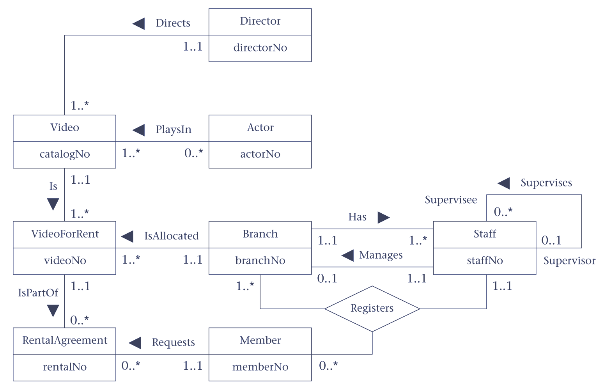
Step 2.1 Map tables - Discuss using example ER
© Pearson Education Limited, 2004

Slide 7
How to represent entities
For each entity in ER model, create a table that includes all the entity’s simple attributes.
For composite attributes, include only the simple attributes.
Where possible, identify the column(s) that make up the primary key in each table.
© Pearson Education Limited, 2004

Slide 8
How to represent entities
In some cases, not yet identified the full set of columns that make up the tables, as still to represent the relationships between entities.
In particular, this means that you cannot identify the columns that make up the primary key for weak entities.
© Pearson Education Limited, 2004

Slide 9
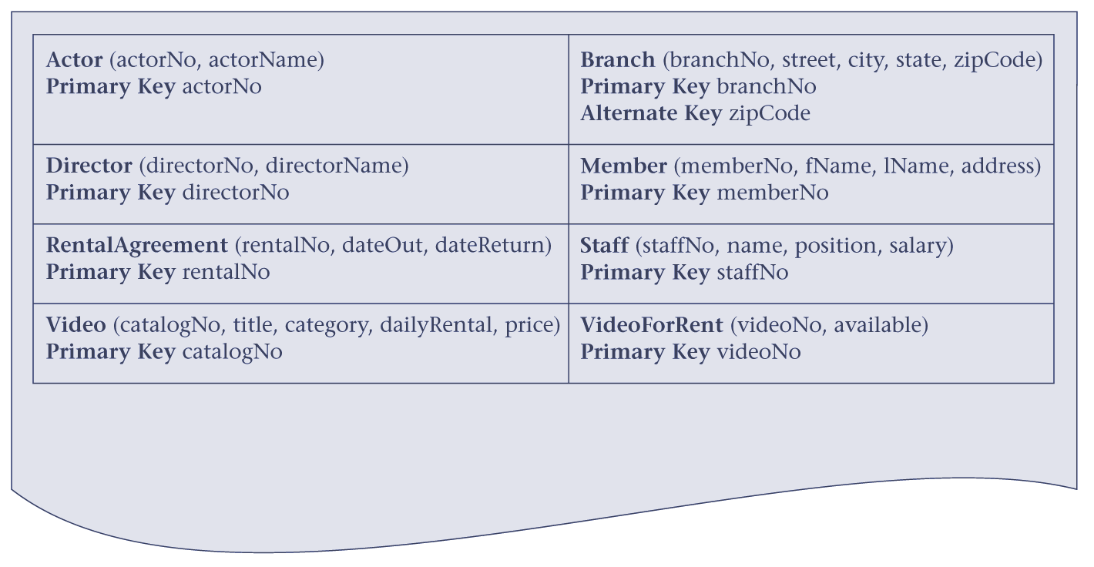
Initial table structures for the entities
© Pearson Education Limited, 2004

Slide 10
How to represent relationships
Use primary key/foreign key mechanism.
In deciding where to post (or place) the foreign key attribute(s), must first identify the ‘parent’ and ‘child’ entities involved in the relationship.
The parent entity refers to the entity that posts a copy of its primary key into the table that represents the child entity, to act as the foreign key.
© Pearson Education Limited, 2004

Slide 11
How to represent relationships
Consider how to represent the following relationships:
  one-to-many (1:*) binary relationships;
  one-to-many (1:*) recursive relationships;
  one-to-one (1:1) binary relationships;
  one-to-one (1:1) recursive relationships;
  many-to-many (*:*) binary relationships;
  complex relationships;
Also, consider multi-valued attributes.
© Pearson Education Limited, 2004

Slide 12
1:*binary relationships
Entity on ‘one side’ of relationship is designated as the parent entity and entity on ‘many side’ is designated as child entity.
A copy of primary key of parent entity is placed into table representing the child entity, to act as a foreign key.
© Pearson Education Limited, 2004

Slide 13
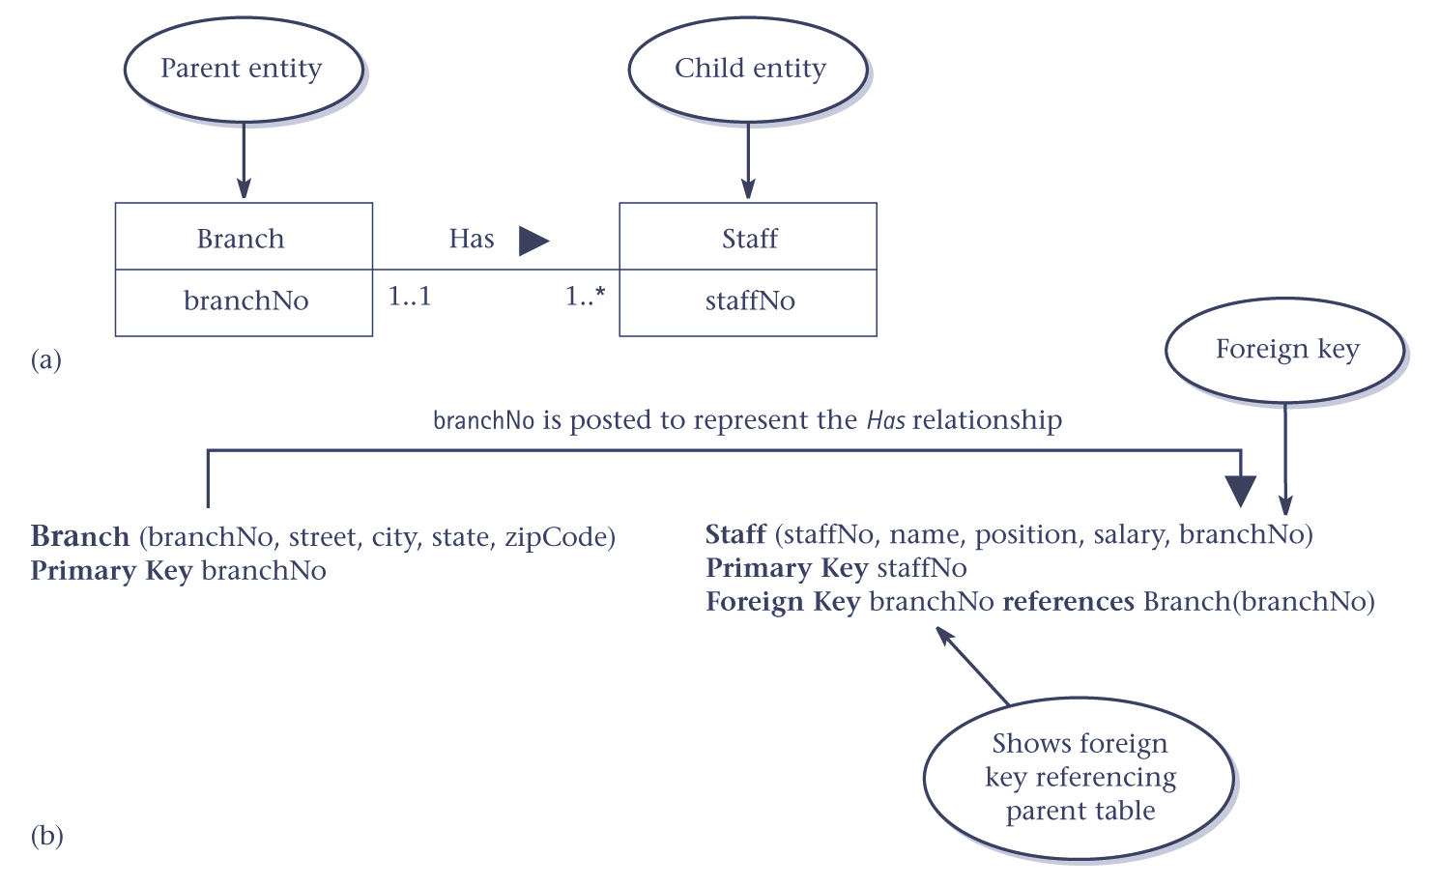
1:* relationship – (a) ER diagram; (b) as tables
© Pearson Education Limited, 2004

Slide 14
1:* recursive relationships
The representation of a 1:* recursive relationship is similar to 1:* binary relationship.
However, in this case, both the parent and child entity is the same entity.
© Pearson Education Limited, 2004

Slide 15
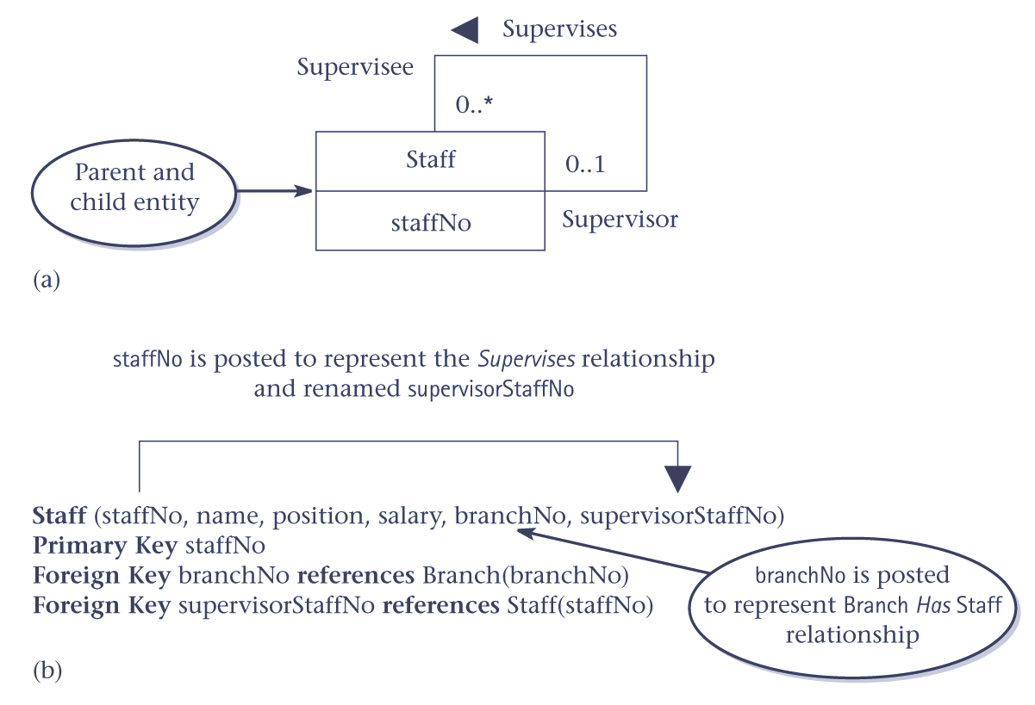
1:* recursive relationships – (a) ER diagram; (b) as tables
© Pearson Education Limited, 2004

Slide 16
1:1 binary relationships
Cannot use cardinality to help identify the parent and child entities.
Instead, use participation to help decide whether it’s best to represent the relationship by combining the entities involved into one table or by creating two tables and posting a copy of the primary key from one table to the other.
© Pearson Education Limited, 2004

Slide 17
1:1 binary relationships
Consider how to create tables to represent the following participation constraints:
  Mandatory participation on both sides of 1:1 relationship
  Mandatory participation on one side of 1:1 relationship
  Optional participation on both sides of 1:1 relationship.
© Pearson Education Limited, 2004

Slide 18
Mandatory participation on both sides of 1:1 relationship
Combine entities involved into one table and choose one of the primary keys of the original entities to be the primary key of the new table, while the other is used as an alternate key.
© Pearson Education Limited, 2004

Slide 19
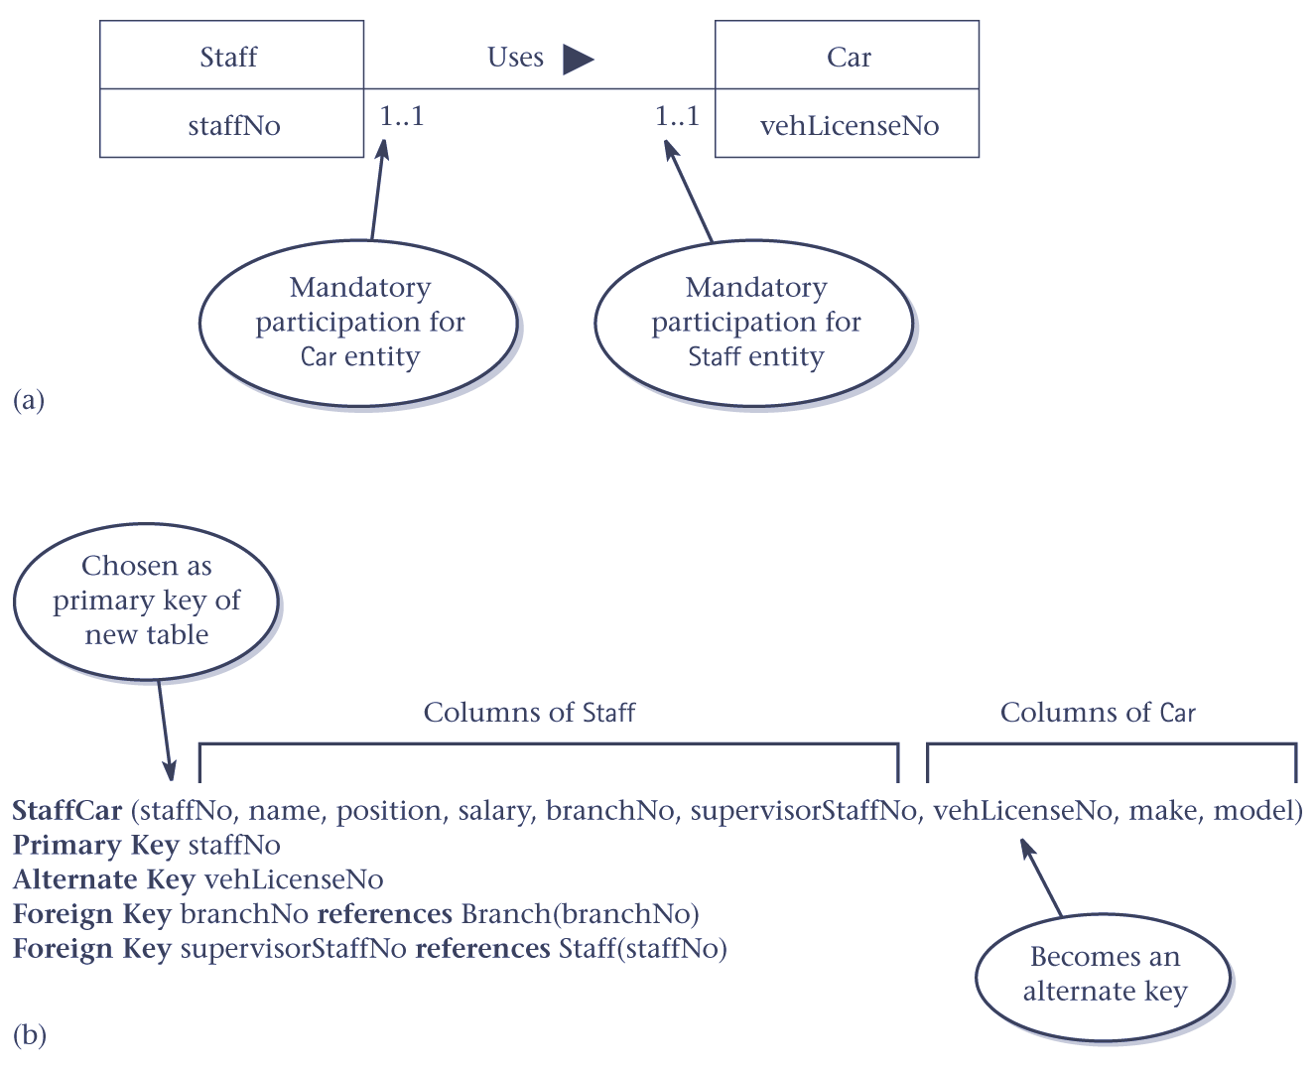
Mandatory participation on both sides of 1:1 relationship – (a) ER diagram; (b) as table
© Pearson Education Limited, 2004

Slide 20
Mandatory participation on one side of a 1:1 relationship
Identify parent and child entities using participation constraints.
Entity with optional participation is parent entity, and entity with mandatory participation is child entity.
A copy of primary key of parent entity is placed in the table representing the child entity.
© Pearson Education Limited, 2004

Slide 21
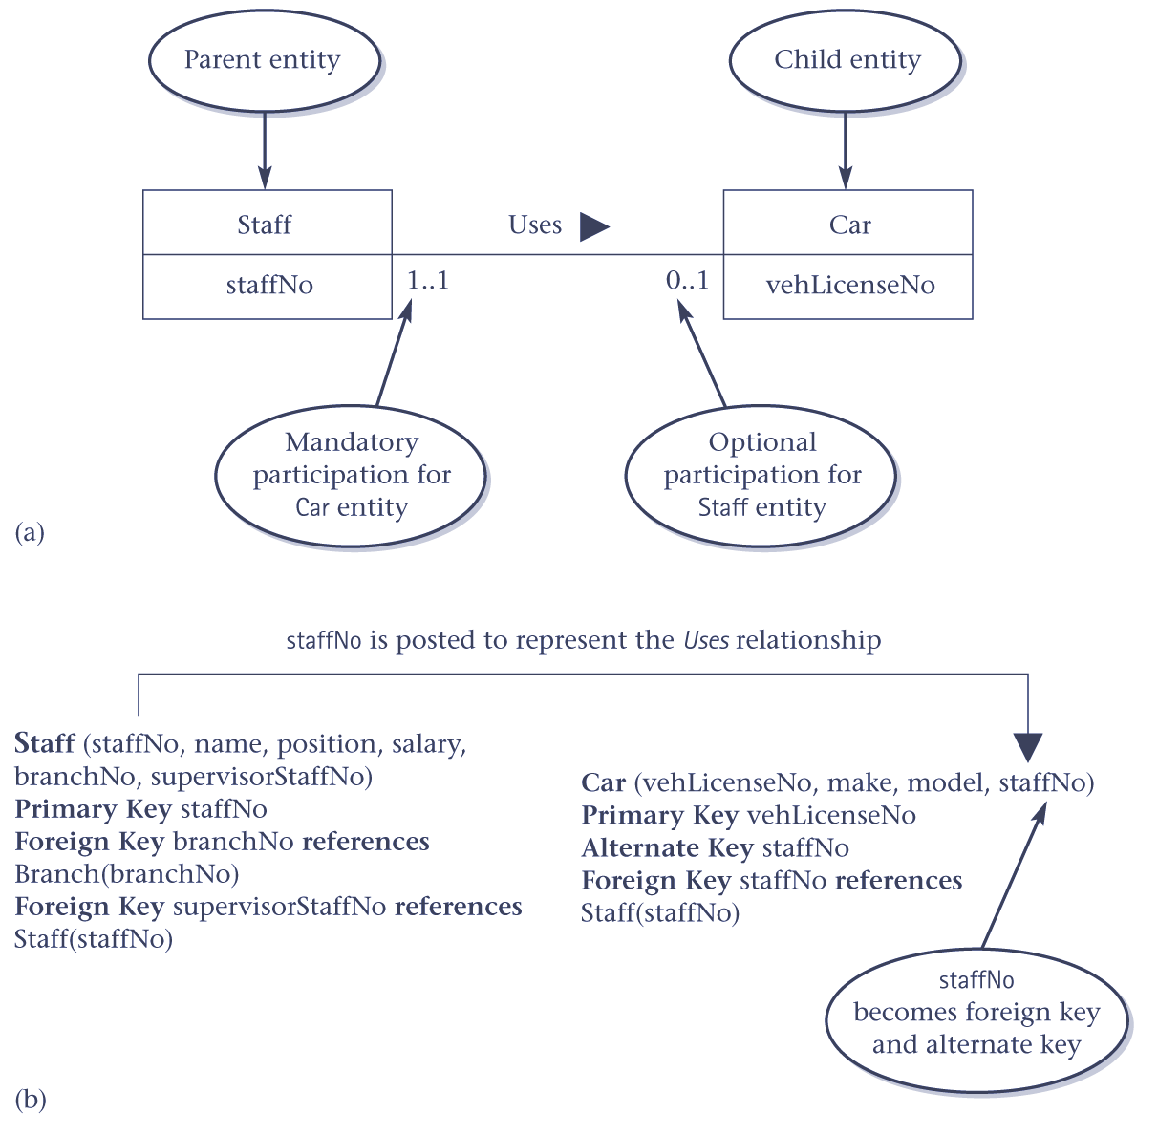
Mandatory participation on one side of a 1:1 relationship – (a)ER diagram; (b) as tables
© Pearson Education Limited, 2004

Slide 22
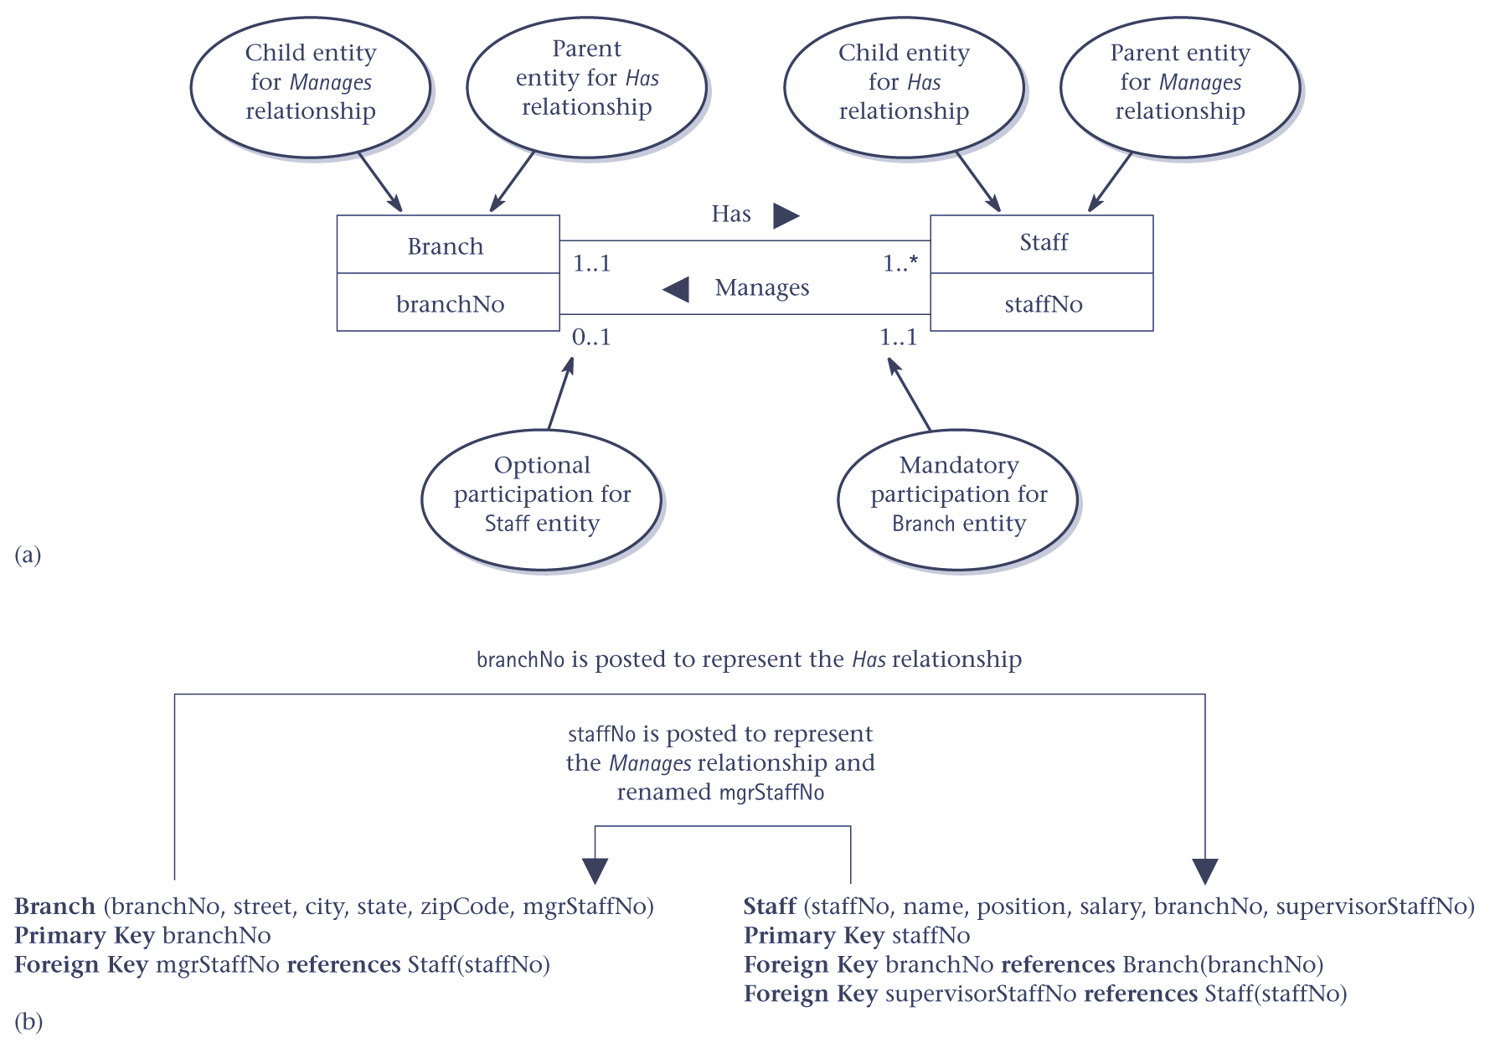
Mandatory participation on one side of a 1:1 relationship (2nd Example)
© Pearson Education Limited, 2004

Slide 23
Optional participation on both sides of a 1:1 relationship
In this case, the designation of the parent and child entities is arbitrary unless you can find out more about the relationship that can help you reach a decision one way or the other.
© Pearson Education Limited, 2004

Slide 24
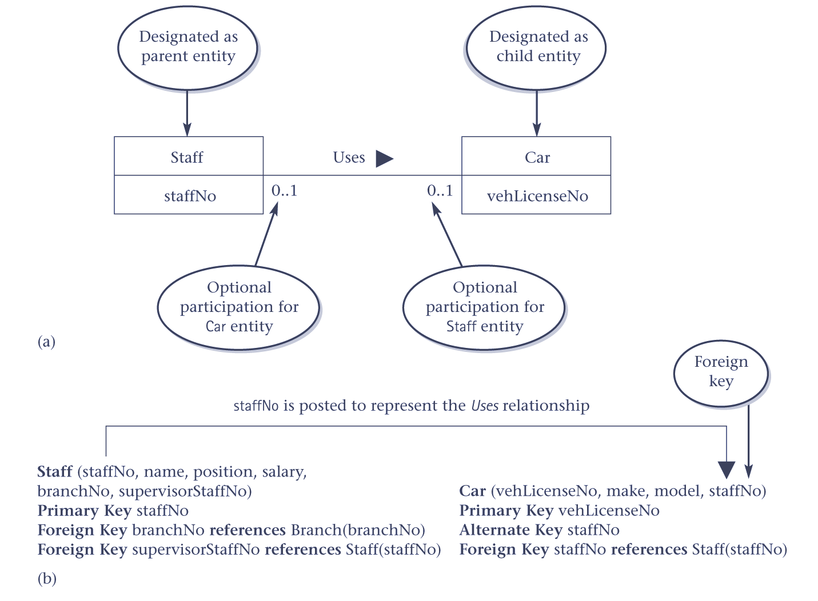
Optional participation on both sides of a 1:1 relationship – (a) ER diagram; (b) as tables
© Pearson Education Limited, 2004

Slide 25
1:1 recursive relationships
Follow rules for participation as described for a 1:1 relationship.
However, in this case, the entity on both sides of the relationship is the same.
© Pearson Education Limited, 2004

Slide 26
1:1 recursive relationships with mandatory participation on both sides
Represent as a single table with two copies of the primary key.
One copy of the primary key represents a foreign key and should be renamed to indicate the relationship it represents.
© Pearson Education Limited, 2004

Slide 27
1:1 recursive relationships with mandatory participation on one side
Can create a single table with two copies of the primary key, or create a new table to represent the relationship.
New table has two columns, both copies of the primary key acting as foreign keys. Must be renamed to indicate purpose of each in the table.
© Pearson Education Limited, 2004

Slide 28
1:1 recursive relationships with optional participation on both sides
For a 1:1 recursive relationship with optional participation on both sides, create a new table as described above.
© Pearson Education Limited, 2004

Slide 29
*:* binary relationships
Create a table to represent the relationship and include any attributes that are part of the relationship.
Post a copy of the primary key attribute(s) of the entities that participate in the relationship into the new table, to act as foreign keys.
© Pearson Education Limited, 2004

Slide 30
*:* binary relationships
One or both of the foreign keys will also form the primary key of the new table, possibly in combination with some of the attributes of the relationship.
© Pearson Education Limited, 2004

Slide 31
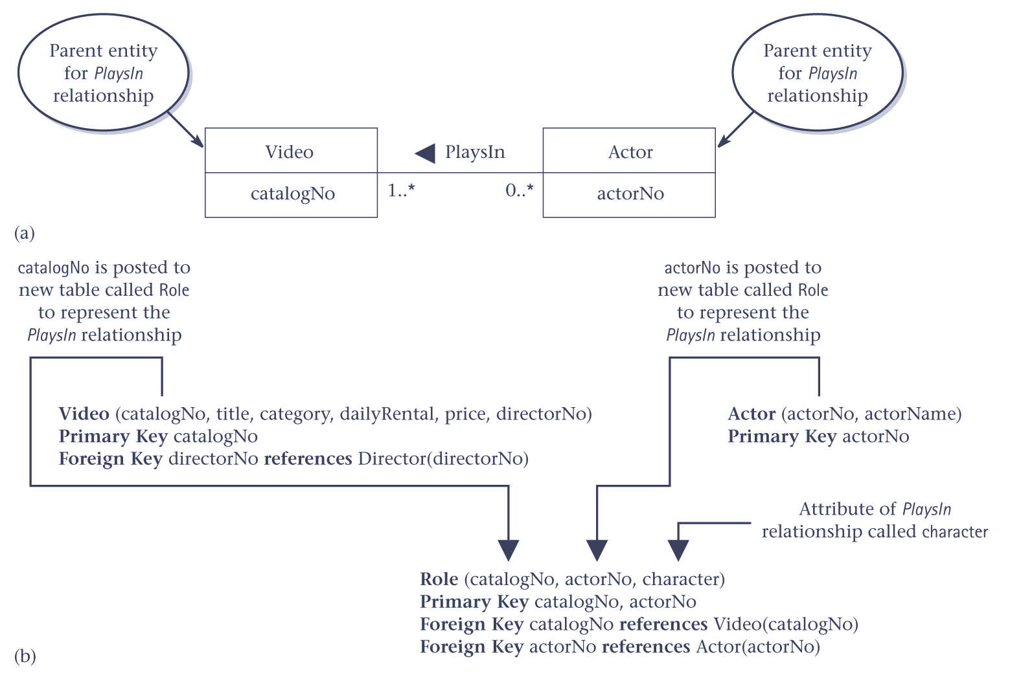
*:* binary relationships – (a) ER diargram; (b) as tables
© Pearson Education Limited, 2004

Slide 32
Complex relationships
Create a table to represent the relationship.
Post a copy of the primary key attribute(s) of the entities that participate in the complex relationship into the new table, to act as foreign keys, and include any attributes that are associated with the relationship.
© Pearson Education Limited, 2004

Slide 33
Complex relationships
One or more of the foreign keys will also form the primary key of the new table, possibly in combination with some of the attributes of the relationship.
© Pearson Education Limited, 2004

Slide 34
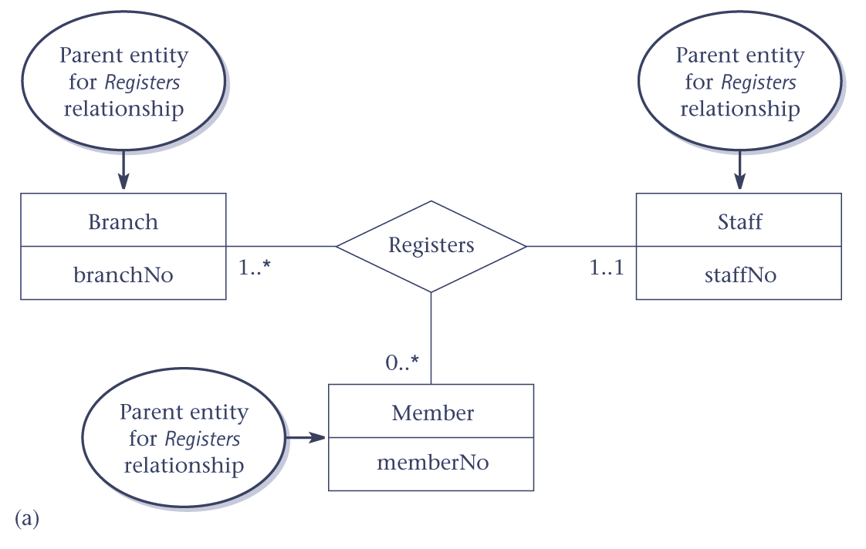
Complex relationship – ER diagram
© Pearson Education Limited, 2004

Slide 35
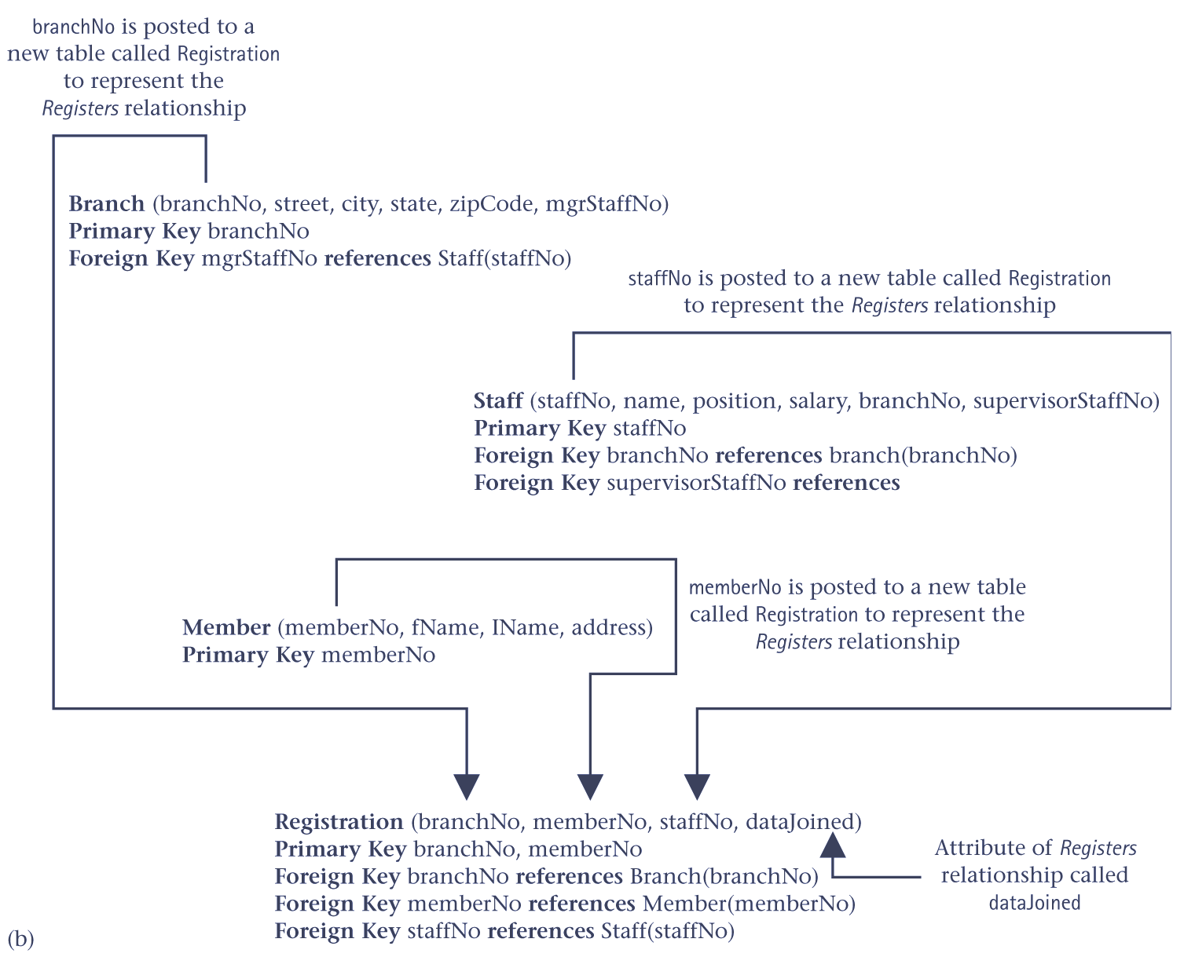
Complex relationship – representation as tables
© Pearson Education Limited, 2004

Slide 36
Multi-valued attributes
A new table is created to hold the multi-valued attribute and the parent entity posts a copy of its primary key, to act as a foreign key.
© Pearson Education Limited, 2004

Slide 37
Multi-valued attributes
Unless the multi-valued attribute is itself an alternate key of the parent entity, the primary key of the new table is composed of the multi-valued attribute and the original primary key of the parent entity.
© Pearson Education Limited, 2004

Slide 38
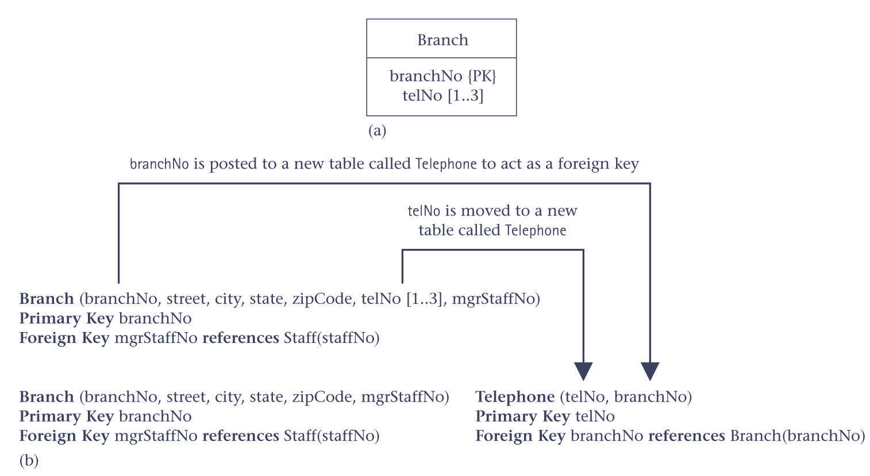
Multi-valued attributes – ER diagram and representation as tables
© Pearson Education Limited, 2004

Slide 39
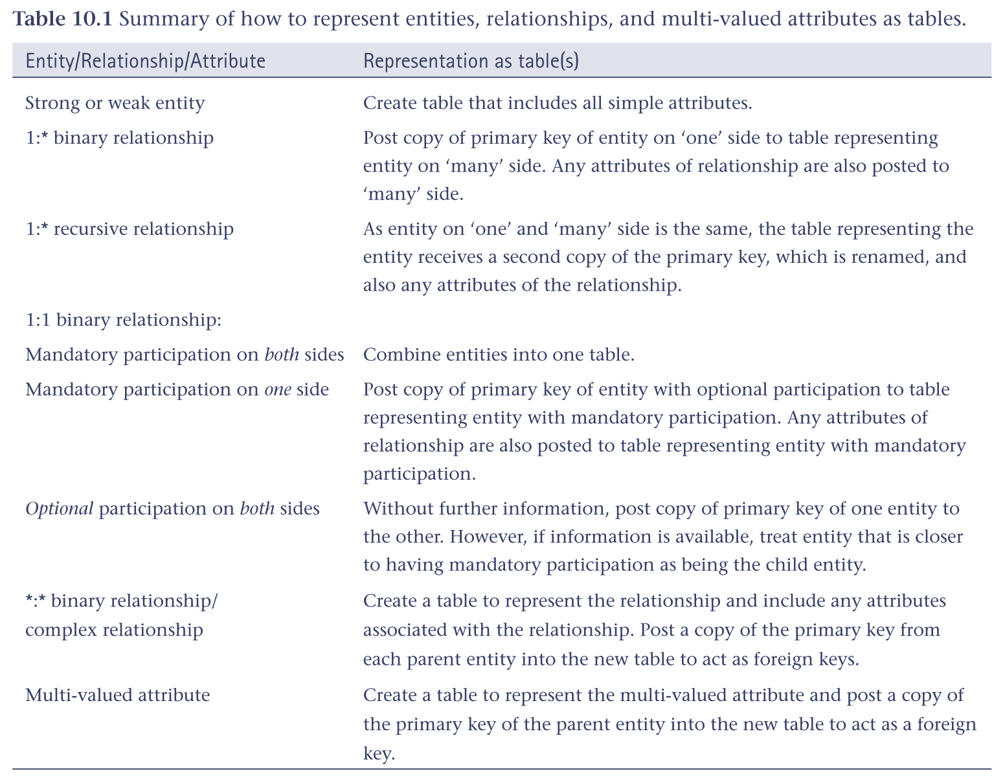
How to represent entities, relationships and multi-valued attributes as tables
© Pearson Education Limited, 2004

Slide 40
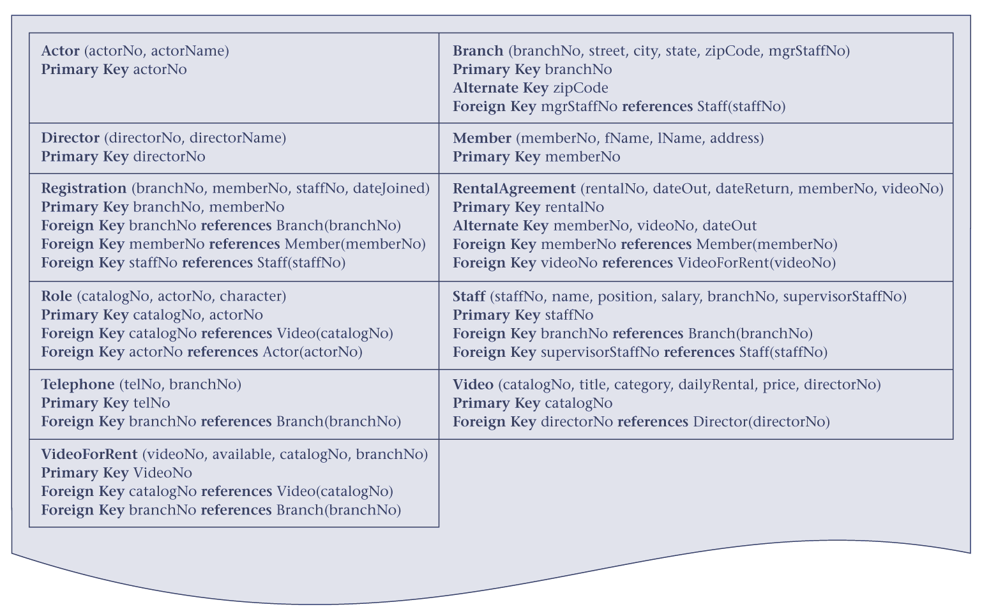
Tables for the Branch user views of StayHome
© Pearson Education Limited, 2004

Slide 41
Step 2.2 Check table structures using normalization
Check composition of each table using the rules of normalization, to avoid unnecessary duplication of data.
Ensure each table is in at least 3NF.
© Pearson Education Limited, 2004

Slide 42
Step 2.2 Check table structures using normalization
If tables are not in 3NF, this may indicate that part of the ER model is incorrect, or that error(s) introduced while creating the tables from the model.
If necessary, may need to restructure the data model and/or tables.
© Pearson Education Limited, 2004

Slide 43
Step 2.3 Check tables support user transactions
Check tables support the required transactions, which were documented in the users’ requirements specification.
Ensures that no error has been introduced while creating tables.
© Pearson Education Limited, 2004

Slide 44
Step 2.3 Check tables support user transactions
One approach is to examine transaction’s data requirements to ensure that the data is present in one or more tables.
If a transaction requires data in more than one table, check these tables are linked through the primary key/foreign key mechanism.
© Pearson Education Limited, 2004

Slide 45
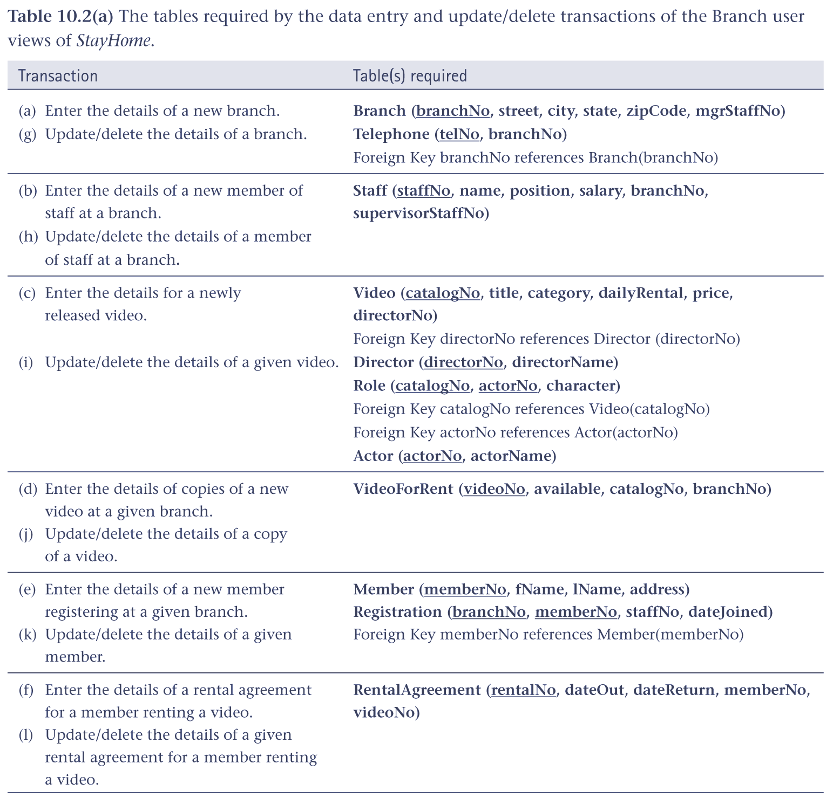
Step 2.3 Check tables support user transactions
© Pearson Education Limited, 2004

Slide 46
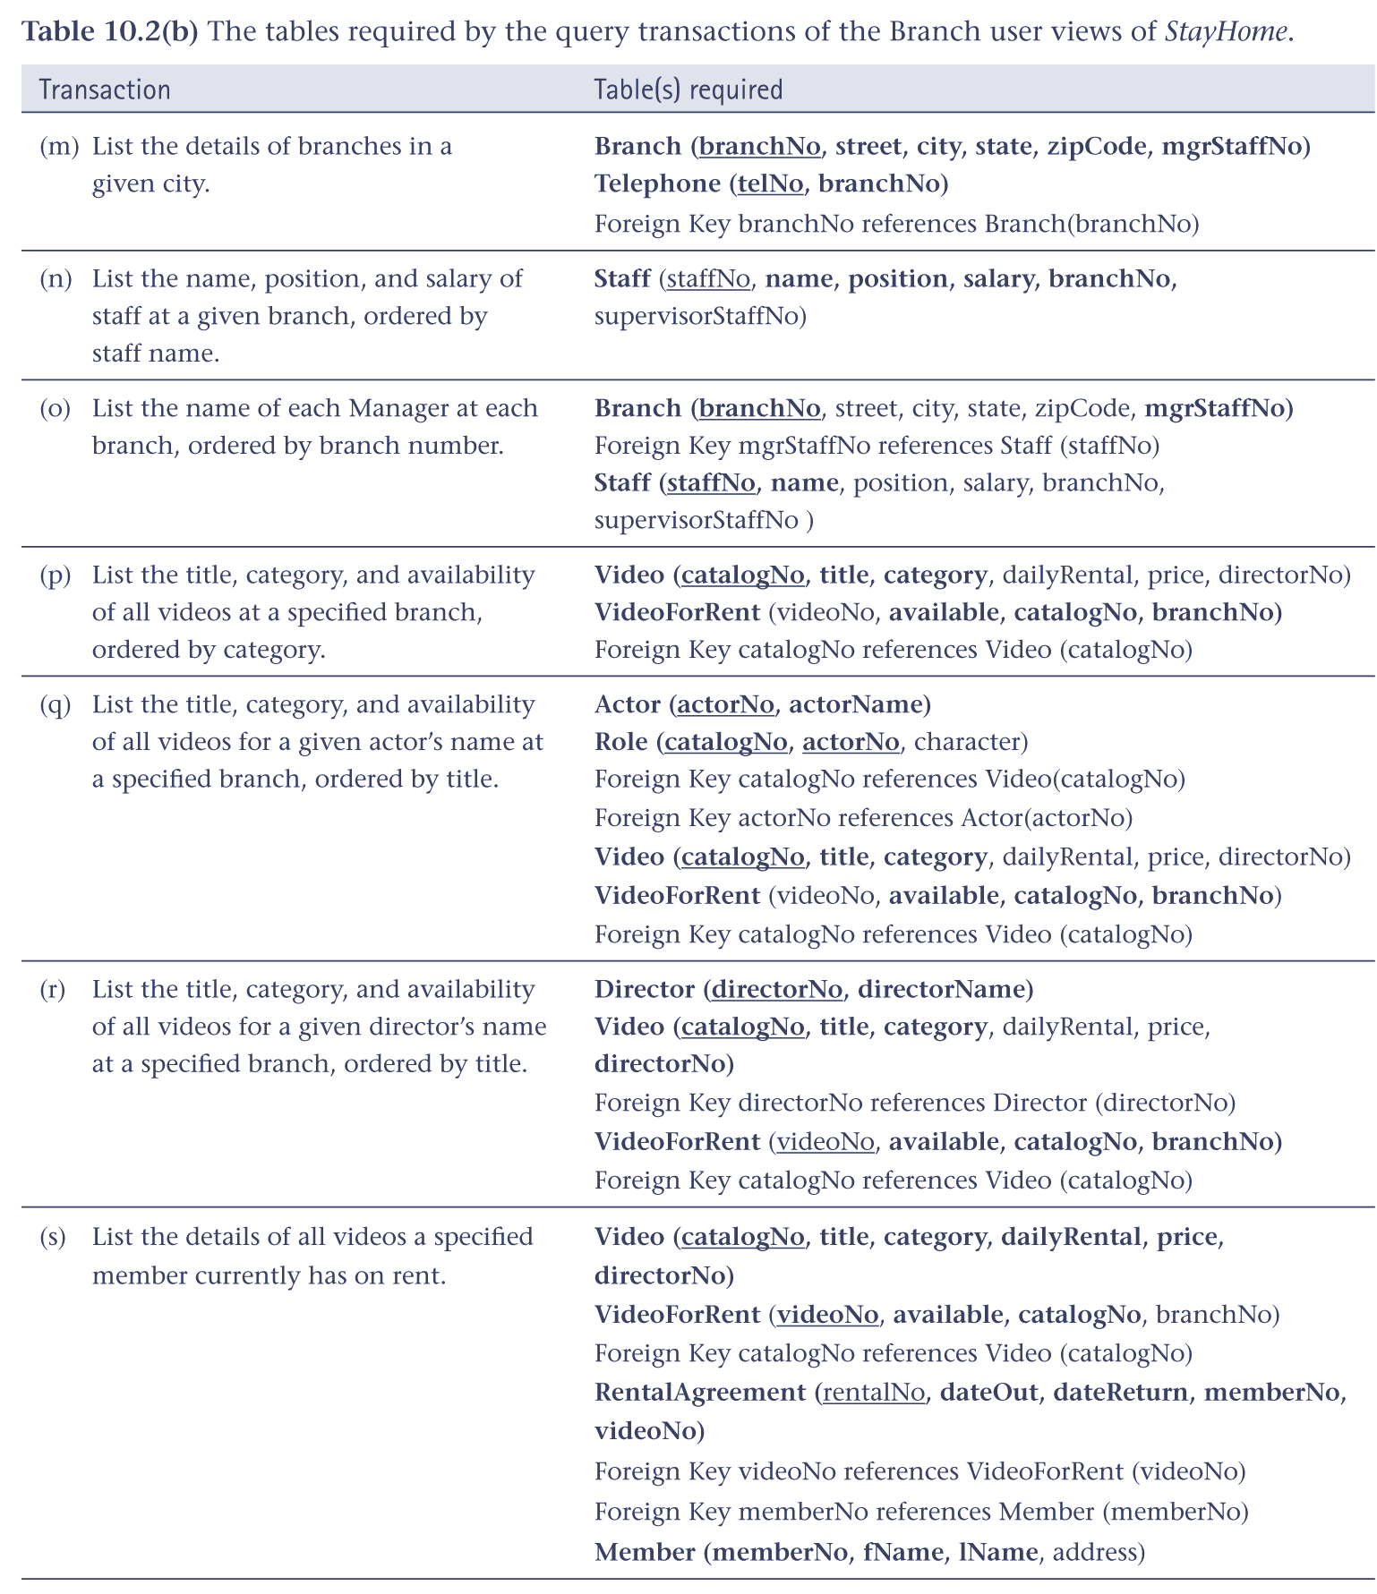
Step 2.3 Check tables support user transactions
© Pearson Education Limited, 2004

Slide 47
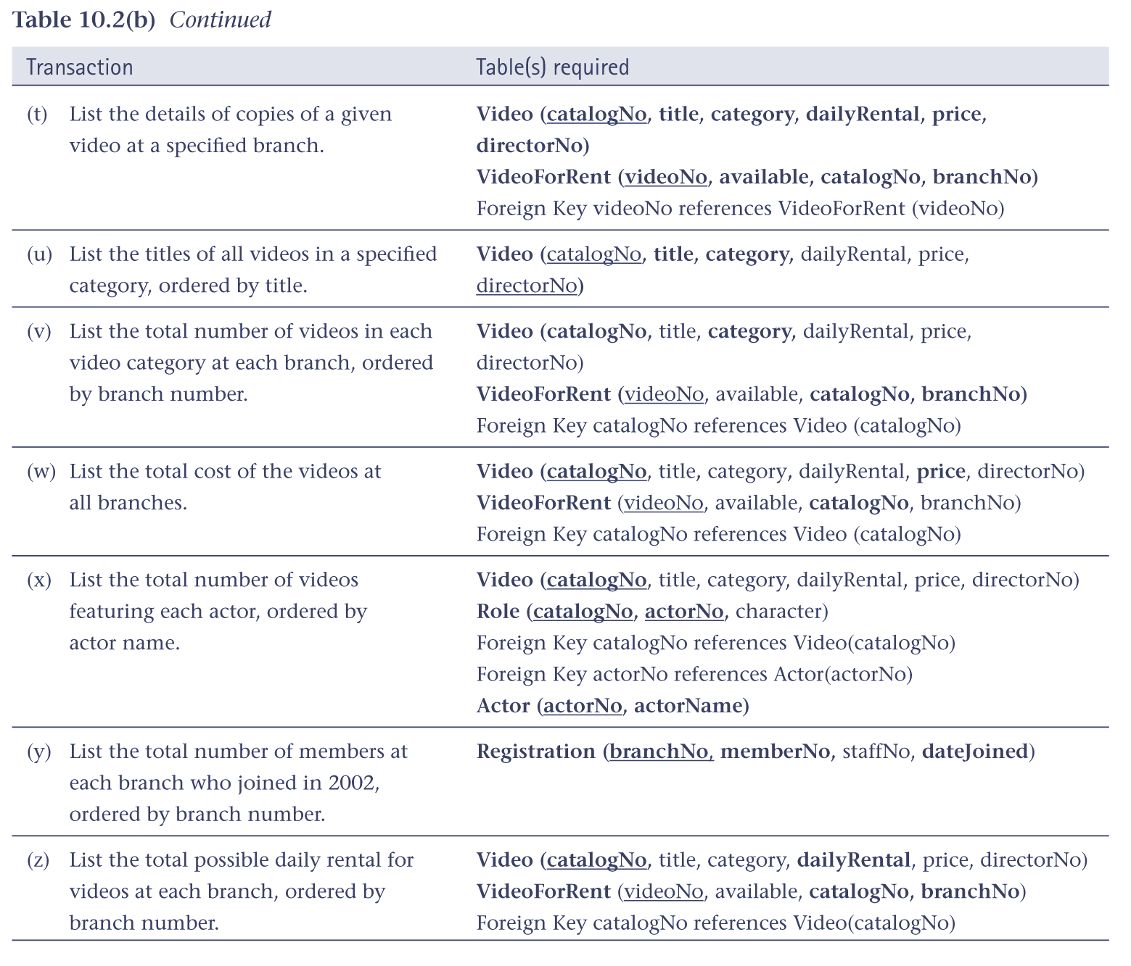
Step 2.3 Check tables support user transactions
© Pearson Education Limited, 2004

Slide 48
Step 2.4 Check business rules
Business rules are the constraints that you wish to impose in order to protect the database from becoming incomplete, inaccurate, or inconsistent.
© Pearson Education Limited, 2004

Slide 49
Step 2.4 Check business rules
Consider the following types of business rules:
  required data,
  column domain constraints,
  entity integrity,
  multiplicity,
  referential integrity,
  other business rules.
© Pearson Education Limited, 2004

Slide 50
Step 2.4 Check business rules
Consider the following types of business rules:
  required data,
  column domain constraints,
  entity integrity,
  multiplicity,
  referential integrity,
  other business rules.
© Pearson Education Limited, 2004

Slide 51
Step 2.4 Check business rules - referential integrity
There are two issues regarding foreign keys
  Are nulls allowed for the foreign key?
  How do you ensure referential integrity?
© Pearson Education Limited, 2004

Slide 52
How do you ensure referential integrity?
Must specify existence constraints, which define conditions under which a primary key or foreign key may be inserted, updated, or deleted.
© Pearson Education Limited, 2004

Slide 53
How do you ensure referential integrity?
Consider the following six cases.
  Case 1: Insert record into child table
  Case 2: Delete record from child table
  Case 3: Update foreign key of child record
  Case 4: Insert record into parent table
  Case 5: Delete record from parent table
  Case 6: Update primary key of parent record
There are several strategies to consider for Case 5
© Pearson Education Limited, 2004

Slide 54
Case 5: Delete record from parent table
Strategies to consider include:
  NO ACTION
  CASCADE
  SET NULL
  SET DEFAULT
  NO CHECK
© Pearson Education Limited, 2004

Slide 55
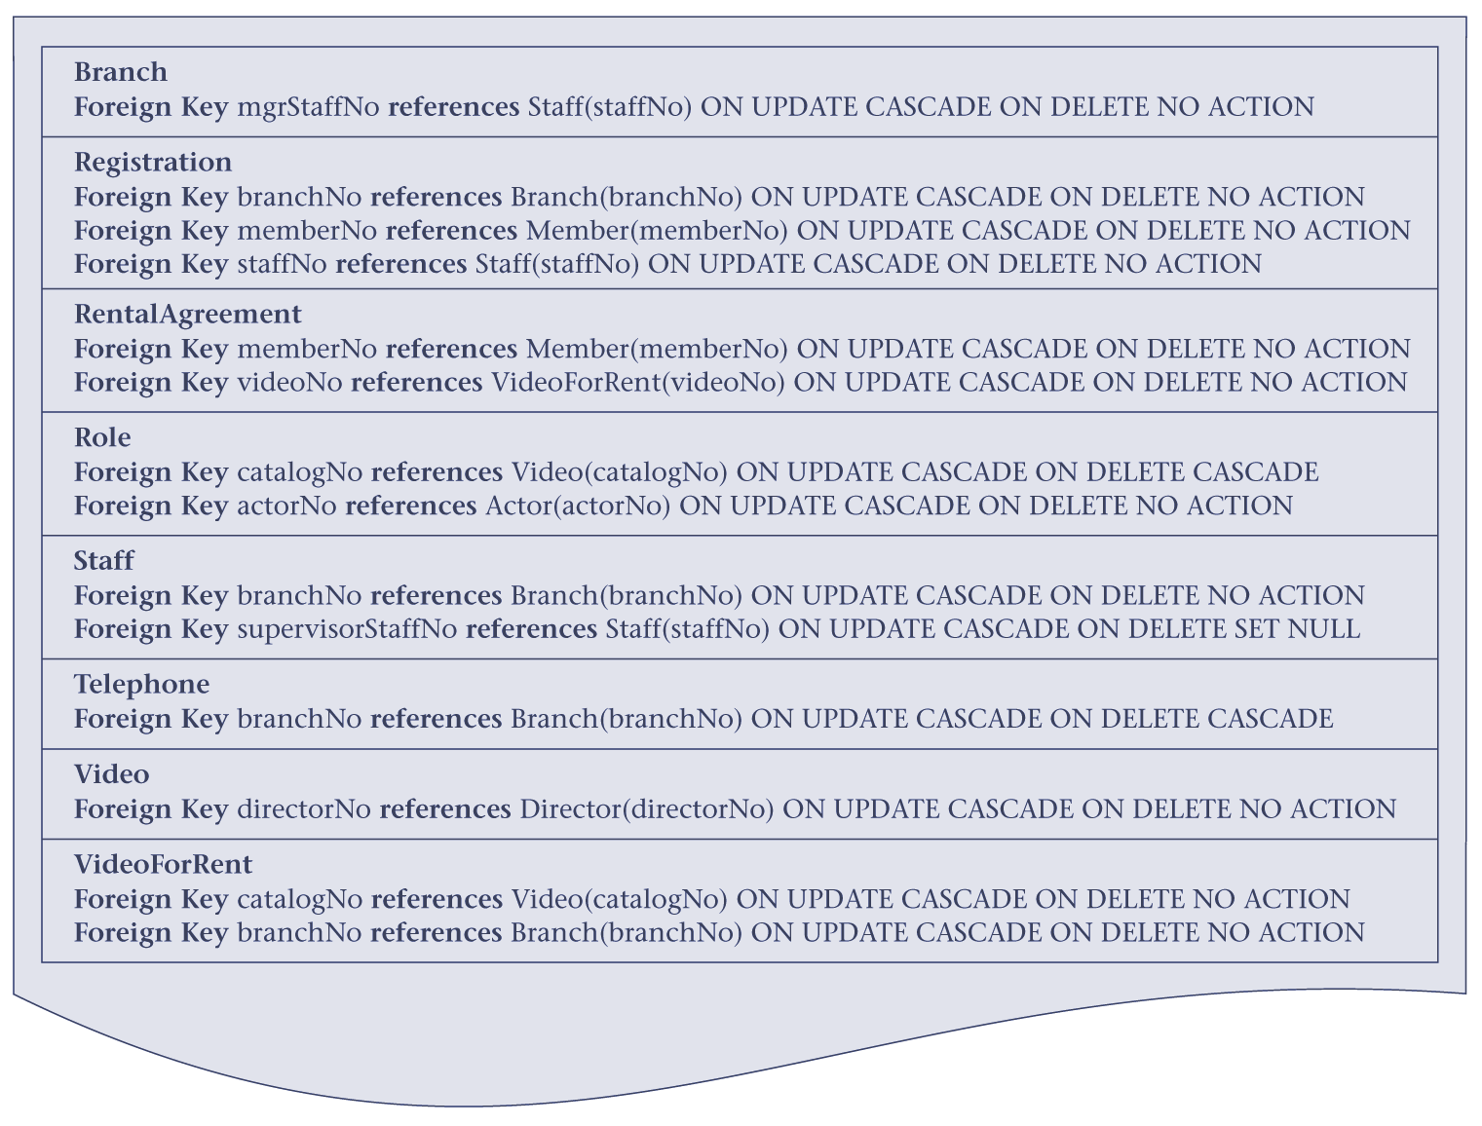
Referential integrity constraints for the tables
© Pearson Education Limited, 2004

Slide 56
Step 2.5 Review logical database design with users
To ensure that the logical database design is a true representation of the data requirements of an organization (or part of the organization) to be supported by the database.
© Pearson Education Limited, 2004

